Slide 1
Understanding selectors

Slide 2
Universal selector
* {
background-color: white;
color: gray;
}

Slide 3
descendant selectors
li a {
text-decoration: none;
}

Slide 4
child selectors
li > a {
text-decoration: none;
}

Slide 5
Pseudo-class selectors
:link Denotes an unvisited link where a:link selects all unvisited links.
■ :visited Denotes visited links where a:visited selects all visited links.
■ :active Denotes an active link when active means that the mouse button is pressed
down and a:active selects all active links.
■ :hover Denotes a link the mouse cursor is over when a:hover selects the link the
mouse is over.
■ :focus Denotes an element that has focus when input:focus selects the input that has
focus.
■ :checked Denotes an option button or check box element whose checked attribute is
set, where input[type=’checkbox’]:checked selects all check boxes that are selected.
■ :lang(language) Denotes an element whose lang attribute is set to language when
p:lang(en) selects all paragraphs and the lang attribute starts with en.
■ :not Provides negation when div:not(“#mainContainer”) selects all <div> elements
except the <div> element whose id is mainContainer.

Slide 6
Pseudo-class selectors
:nth-child(formula) Selects the nth child of a parent if the formula is an integer
value. For example, li:nthchild(3) selects the third list item. Note that the number is
one-based, not zero-based. This pseudo class is powerful.
You can provide a formula based on an + b when a is cycle count and n is a counter
variable, and b represents the element within the cycle that you want to select. For
example, li:nthchild(10n + 3) selects the third element of every 10 elements, so if a
<ul> element contains 45 <li> elements, elements 3, 13, 23, 33, and 43 will be selected.
You can also use the keywords odd and even to select odd and even child elements.
For example, li:nth-child(odd) selects elements 1, 3, 5, 7, and so on.
■ :nth-last-child(n) Selects the nth child of a parent if the formula is an integer value.
For example, li:nth-last-child(3) selects the third list item from the end of the list. Note
that the number is one-based, not zero-based.
■ :only-child Selects elements that are the only child of the parent.
■ :only-of-type Selects elements that are the only child of the parent and have the
specified type.
■ :first-of-type Selects the first element of the specified type.

Slide 7
pseudo elements
■ ::first-line Selects the first line where p::first-line selects the first line of each paragraph.
You can apply a different style to the first line of a paragraph.
■ ::first-letter Selects the first letter where p::first-letter selects the first letter of each
paragraph. You can apply a different style to the first letter of a paragraph. This option
is useful when you want to create a large first letter.
■ ::before Inserts generated textual content inside the element where
p::before{ content: “Note: “; } inserts “Note: “ into each paragraph directly before the
existing content. In addition to adding the textual content, you can provide a style
for the content when p::before{ content: “Note: “; color: red;} sets the color of “Note: ”
to red.
■ ::after Inserts generated textual content inside each element when p::after{ content:
“Done!“; } inserts “Done!” into each paragraph directly after the existing content. In
addition to adding the textual content, you can provide a style for the textual content
when p::after{ content: “Done!”; color: red;} sets the color of “Done!” to red.

Slide 8
Subsequent sibling , adjacent sibling
Sibling (~)
div ~ h1 {
background-color: yellow;
}
adjacent (+)
div + h1 {
background-color: yellow;
}

Slide 9
Grouping selectors
button {
background-color: white;
color: gray;
}
p {
background-color: white;
color: gray;
}
button, p {
background-color: white; color: gray;
}

Slide 10
attribute selector
a[href]:hover:after {
content: " (" attr(href) ")";
background-color: yellow;
}

Slide 11
attribute value selector
a[href='http://contoso.com']:hover {
background-color: yellow;
}

Slide 12
attribute contains value selector
a[href*='contoso.com']:hover {
background-color: yellow;
}

Slide 13
attribute value starts with selector
a[href^='http']:hover {
background-color: yellow;
}

Slide 14
attribute value ends with selector
a[href$='jpg']:hover {
background-color: yellow;
}

Slide 15
attribute contains value in list selector
a[data-linktype ~='externalLink'] {
background-color: yellow;
}

Slide 16
How do styles cascade?
!Important
Specificity
Textual Order

Slide 17
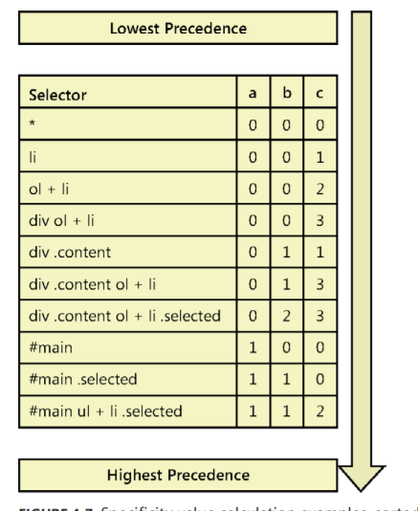
Using specificity
■ a Record the number of id attributes in the selector.
■ b Record the quantity of class selectors, attributes selectors, and pseudo classes.
■ c Record the quantity of element names in the selector

Slide 18
Working with CSS colors
color names : Yellow, red
hexadecimal notation: #fff
RGB (r,g,b)
h1 { background-color: rgb(255,0,0); }
h1 { background-color: rgb(-100,500,0); } /*interpreted as 0,255,0 */
h1 { background-color: rgb(20%,150%,0%); } /*interpreted as 20%,100%,0% */
ARGB (alpha-rgba(r,g,b,opacity)
h1 { background-color: rgba(255,0,0,0.5); }
h1 { background-color: rgba(0,255,0,1); }
h1 { background-color: rgba(20%,50%,0%, 0.2); }

Slide 19
Working with text
■ serif Font families with serifs or curls at the top and bottom of characters, such as Times New Roman
■ sans serif Font families without serifs, such as Arial
■ monospace Font families in which all characters have the same width, such as Courier New
■ cursive Font families that imitate handwriting, such as Mistral
■ fantasy Font families that are decorative and used in titles, such as Impact

Slide 20
Setting the font-family property
h1 { font-family: arial, verdana, sans-serif; }
h1 { font-family: "times new roman", serif; }
h1 { font-family: "courier new", monospace; }

Slide 21
Specifying the font size
■ em A relative measurement multiplier of the parent element’s computed font size
h1 { font-size: 1.2em; }
■ px An absolute measurement pixel unit, 96 pixels per inch
h1 { font-size: 12px; }
■ pt An absolute measurement point unit, 72 points per inch
■ pc An absolute measurement pica unit, 12 points per pica
■ in An absolute measurement inch unit
h1 { font-size: 1in; }
■ mm An absolute measurement millimeter unit
■ cm An absolute measurement centimeter unit
h1 { font-size: 2cm; }

Slide 22
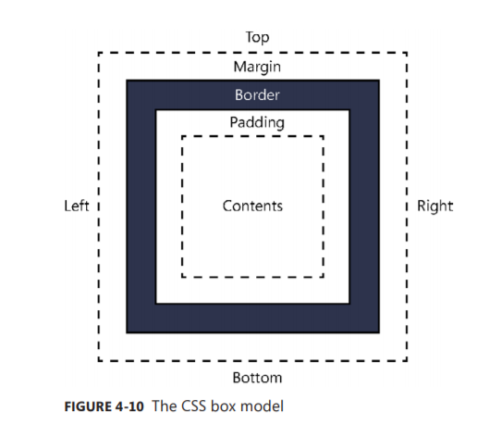
Working with the CSS box model

Slide 23
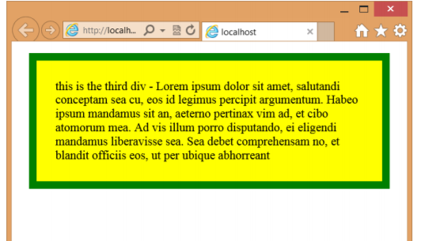
Setting the border, padding, and margin properties
p {
border: 10px;
padding: 25px;
margin: 15px;
background-color: yellow;
border-style: solid;
border-color: green;
}

Slide 24
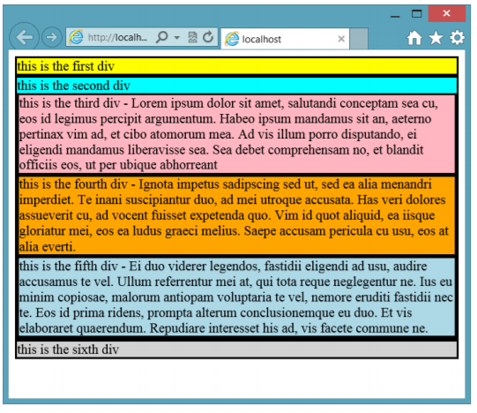
Positioning <div> elements

Slide 25
Use the position property
Static
Relative
Absolute
Fixed

Slide 26
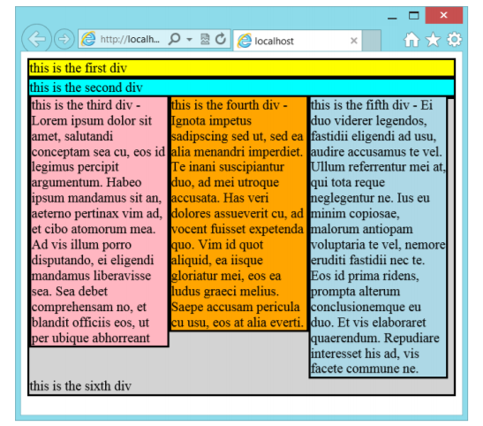
Using the float property
Float:left
Float:Right

Slide 27
Using the clear property
#div6 { background-color: lightgray; clear: both; }

Slide 28
Using the box-sizing property
■ content-box The default setting; calculates the width based on the content width only.
■ border-box Calculates the width based on the border, padding, and content width.
■ padding-box Calculates the width based on the padding and content width.

